Slide 1
Democracy means that power is ultimately in the hands of the whole population and no smaller group has the right to rule.
“of the people, by the people and for the people "Lincoln
UK Democracy
1) Free media = challenges gvt policy and exposes misdeeds eg expenses scandal/money for peerages, with no evidence to suggest that gvt try control info
2) Independent judiciary = upholds the rule of law (all must follow the law including those who create and enforce and must be held to account if they don’t) plus the HRA
3) Devolved governments = power has been moved away (dispersed) from Westminster and closer to the people and now decisions are made closer to those who are affected = good for representation
4) Free and fair elections = largely free of corruption and intimidation overseen by the independent Electoral Commission – opportunities to vote in referendums
5) Wide range of political parties and pressure groups = pluralistic, wide range of representation available and interplay of various ideas and competition arguments = good for representation
Types of democracy:
Direct:
Individuals express opinions themselves
Citizens are more active in decision-making
Not Elective
Representative:
Citizens select representatives to take decisions on their behalf
All adult citizens have the right to vote for representatives
Citizens delegate their authority to their representatives
Elections are free and fair
A Wider Franchise
All adults over the age of 18 are eligible to vote provided they have registered to vote including Commonwealth citizens and UK citizens who have lived abroad for les than 15 yrs
Those excluded include:
      people under 18
      EU citizens although the can vote in local elections
      Members of the HoL
      Prisoners
      Those who have been compulsorily detained in a psychiatric hospital
      Those convicted of a corrupt or illegal electoral practice, who are barred for 5 years
Participation Crisis???!!!!!!
alienation with system
parties too similar
vote doesn’t count
scepticism/political scandal
uniformed, uneducated – not pushed
rather join a PG or maybe everyone is content
Apathy = lack of interest or awareness
Hapathty = general contentment (happiness and apathy)

Slide 2
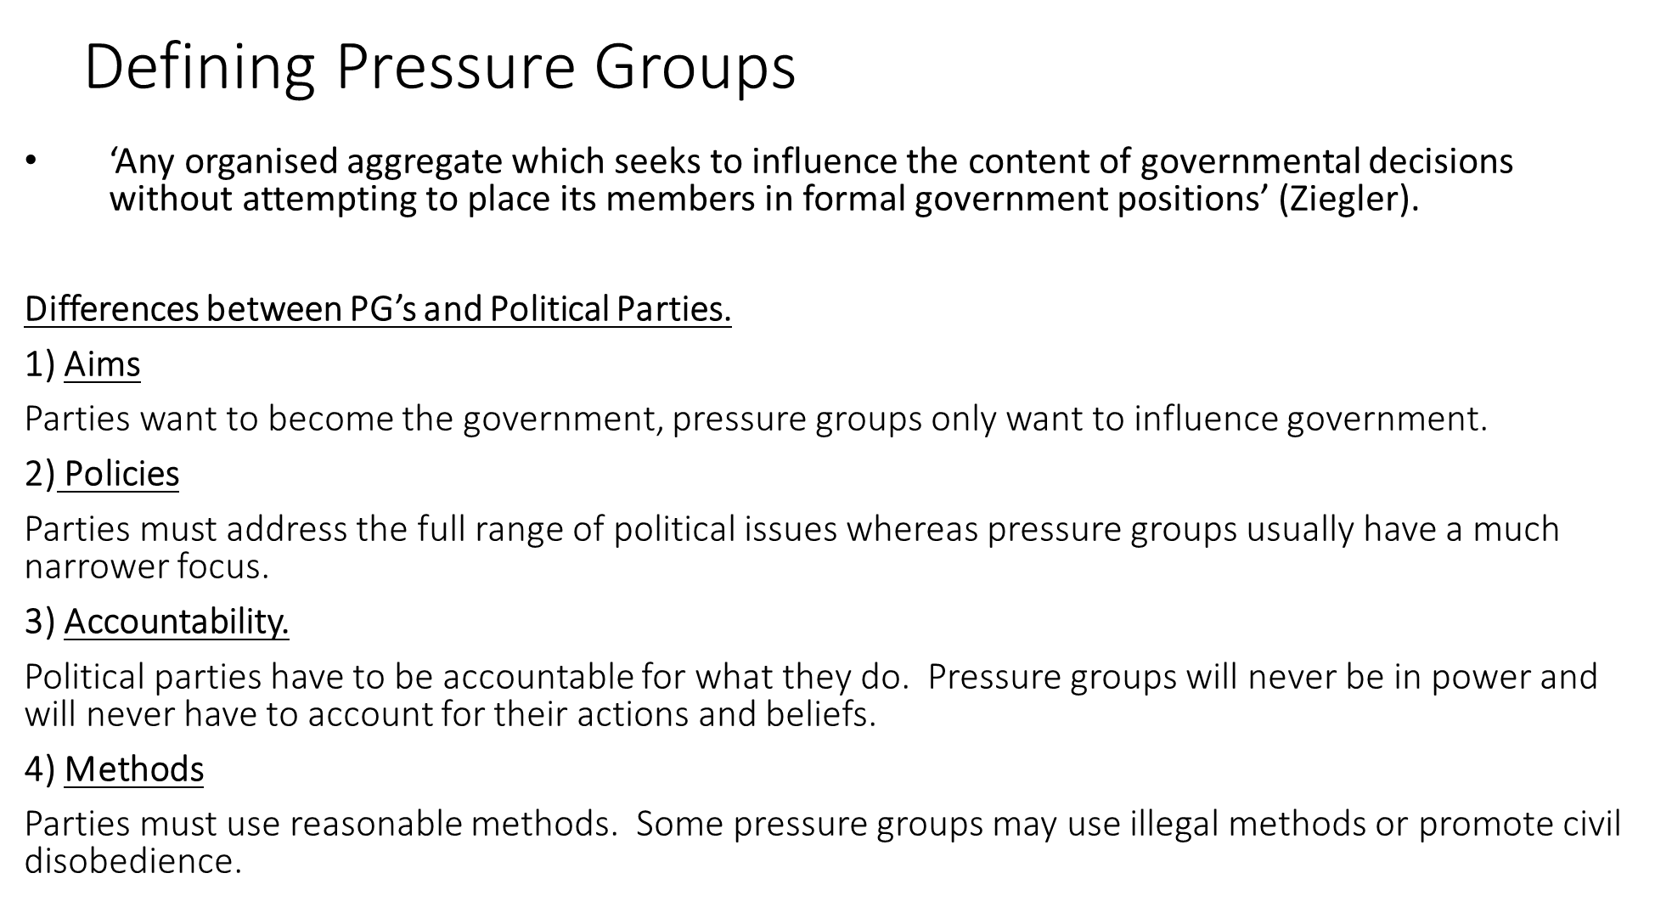
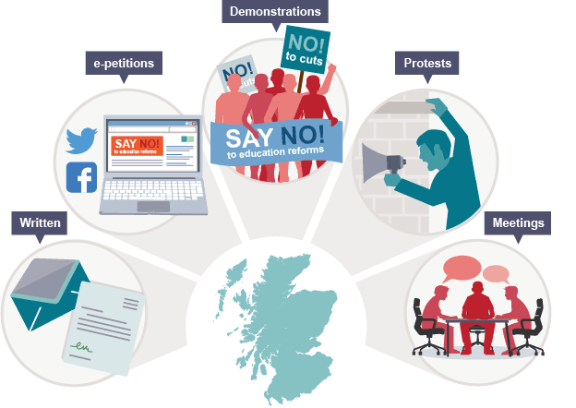
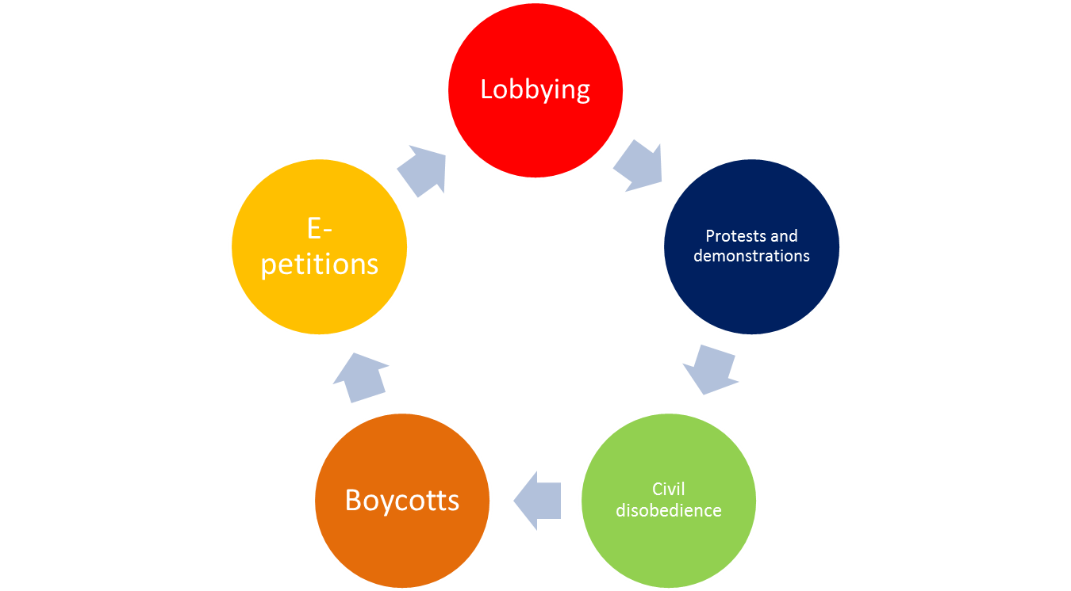
MUST KNOW THESE TOO!
Think tanks – public policy research organisations that seek to influence government policy
Lobbyists – Individuals/organisations paid by their clients to try to influence those in government (such as ministers and MPs) to act in their client's interests
Corporations - Large business organisations also seek to influence policy

